Slide 1



Great Datasets: A Story
Alex Cookson
@alexcookson
tacookson
_

Slide 2
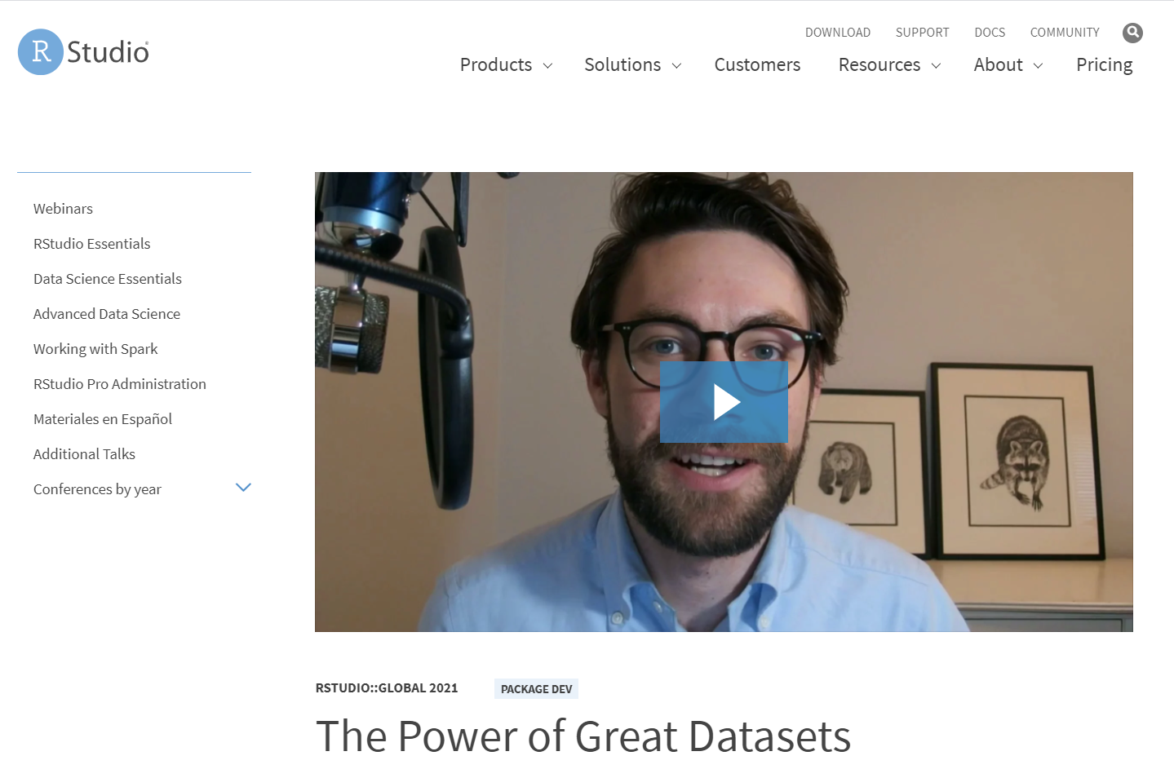
Bored? Busy?
Watch the 5-minute version of this talk

Slide 3
How do love stories usually go?

Slide 4
Non-binary person meets Boy
Non-binary person meets Girl
Girl meets Girl
Boy meets Girl
Girl meets Boy
Boy meets Boy
Non-binary person meets Non-binary person

Slide 5
Non-binary person meets Boy
Non-binary person meets Girl
Girl meets Girl
Boy meets Girl
Girl meets Boy
Boy meets Boy
Non-binary person meets Non-binary person
Learner meets Data

Slide 6
Ever seen a romantic comedy?

Slide 7
Ever seen a romantic comedy?
The Meeting

Slide 8
Ever seen a romantic comedy?
The Meeting
Sparks Fly

Slide 9
Ever seen a romantic comedy?
The Meeting
Sparks Fly
Tension / Crisis

Slide 10
Ever seen a romantic comedy?
The Meeting
Sparks Fly
Tension / Crisis
Falling In Love

Slide 11

The Meeting: Hamilton
Hamilton tickets for Christmas!
My brother the Broadway fan
Weekly grosses: tickets sales, ticket prices, percent of seats sold – all the way back to 1985

Slide 12

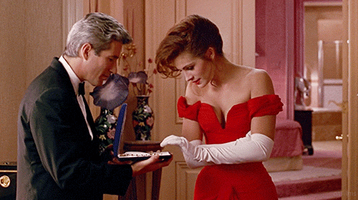
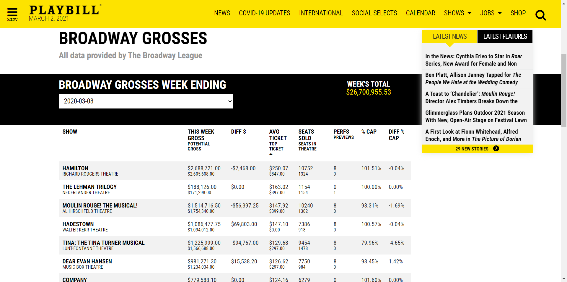
Sparks Fly: Weekly Grosses on Playbill

Slide 13
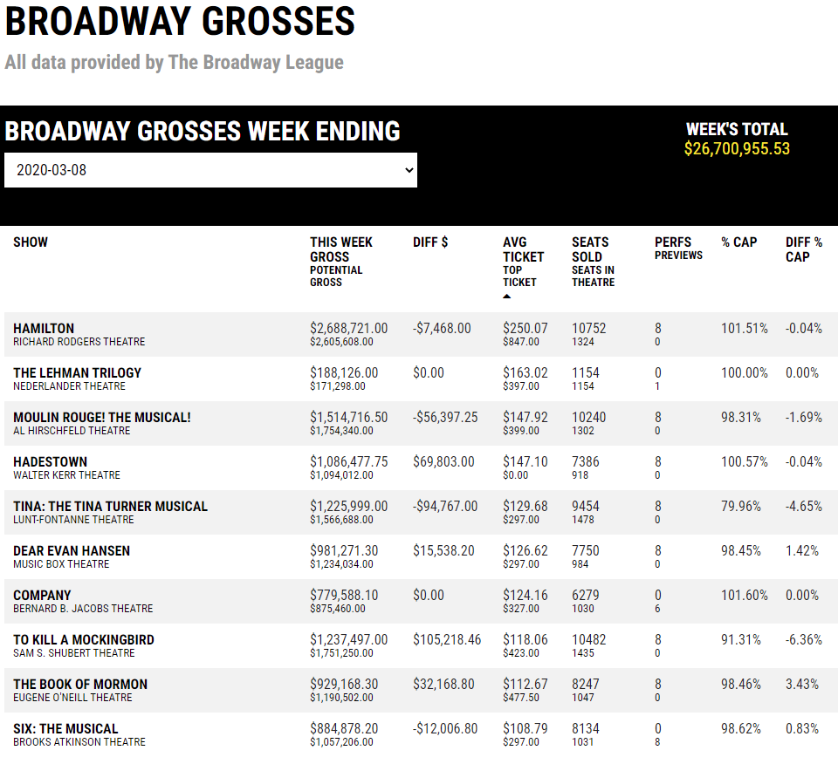

Slide 14
Are Hamilton tickets on Broadway really that expensive?

Slide 15
Yes! $250 (USD) a pop!
($850 if you’re fancy)

Slide 16
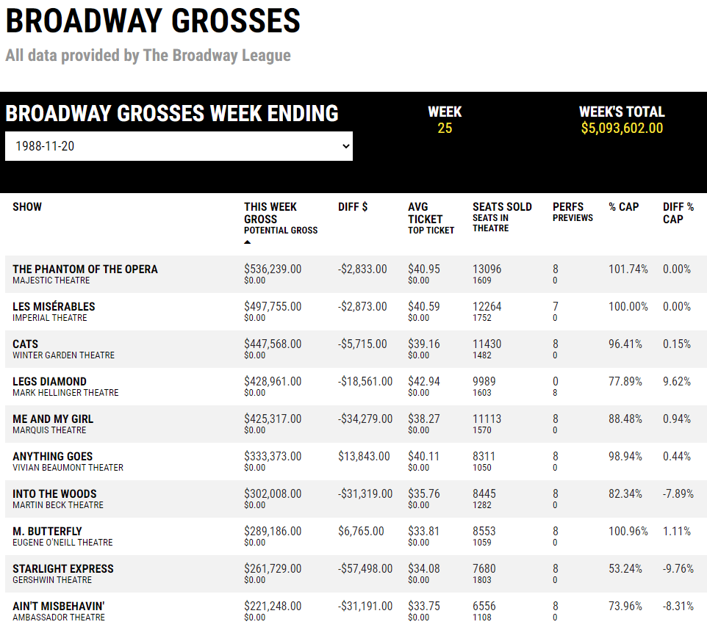
What was popular the week I was born?

Slide 17
Phantom, Les Mis, and Cats!

Slide 18
What’s the highest-grossing show EVER?

Slide 19
What’s the highest-grossing show EVER?
Have average ticket prices gotten more expensive?

Slide 20
Is there any seasonality to ticket prices?
What’s the highest-grossing show EVER?
Have average ticket prices gotten more expensive?

Slide 21
Is there any seasonality to ticket prices?
Do revivals perform as well as their originals?
What’s the highest-grossing show EVER?
Have average ticket prices gotten more expensive?

Slide 22
Is there any seasonality to ticket prices?
Is Hamilton’s success unprecedented?
Do revivals perform as well as their originals?
What’s the highest-grossing show EVER?
Have average ticket prices gotten more expensive?

Slide 23
Is there any seasonality to ticket prices?
???
Is Hamilton’s success unprecedented?
Do revivals perform as well as their originals?
What’s the highest-grossing show EVER?
Have average ticket prices gotten more expensive?

Slide 24

Tension / Crisis: Stuck!
I didn’t want data (one week at a time) – I wanted DATA
The data was right there, but I couldn’t get to it

Slide 25

Tension / Crisis: Stuck!
Should I learn how to web scrape?

Slide 26
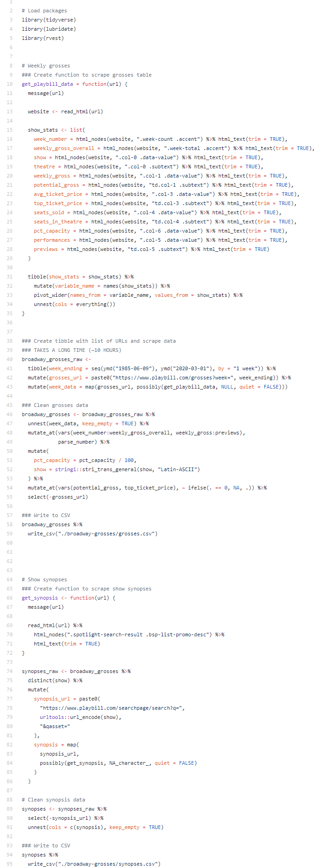
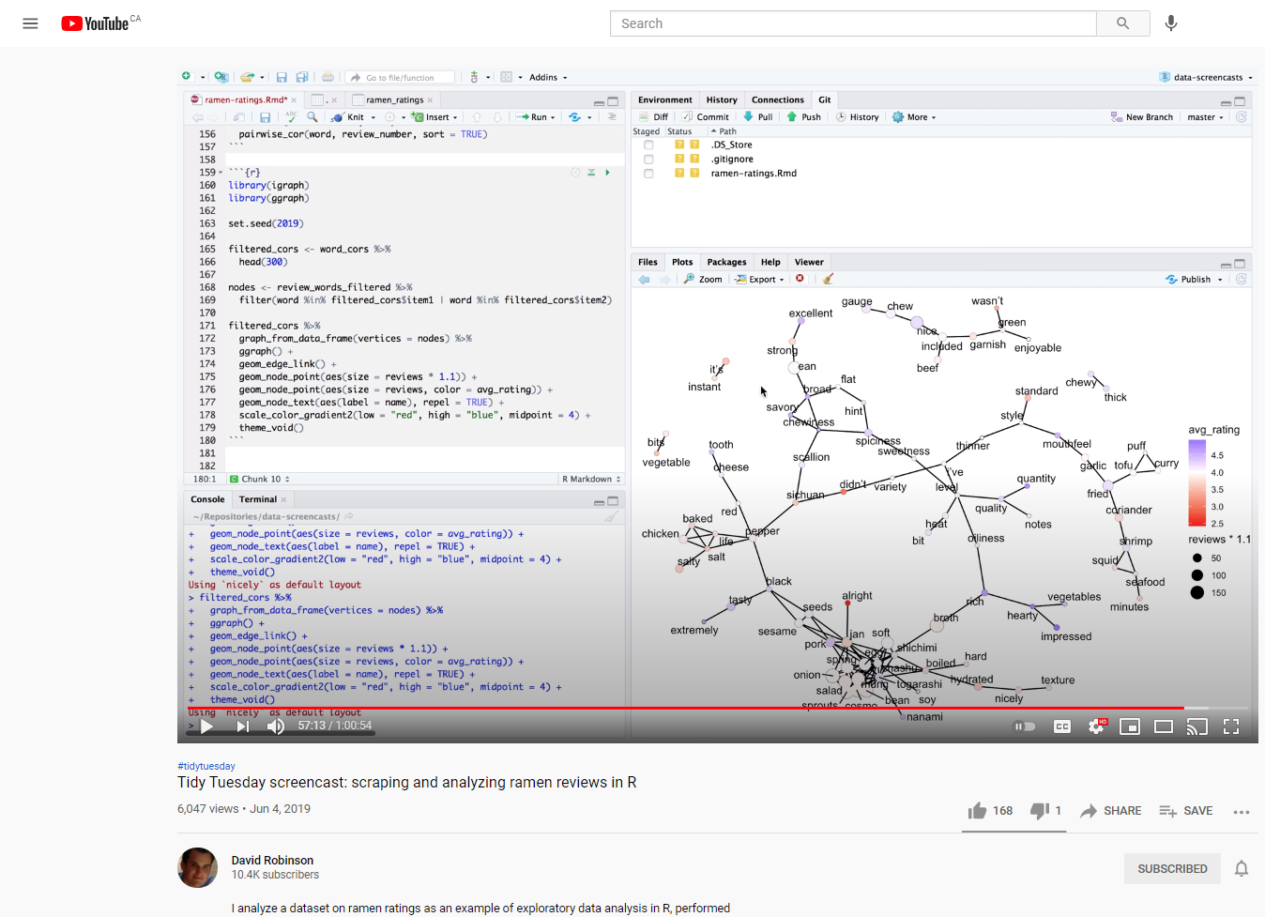

Tension / Crisis: Stuck!
+
=

Slide 27
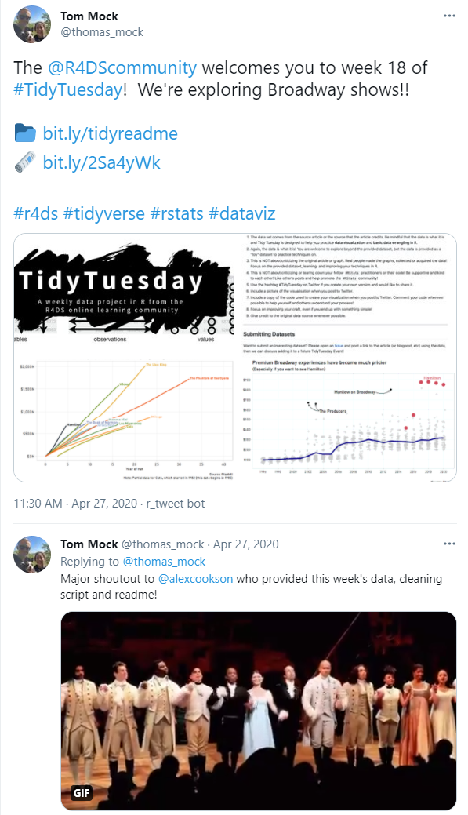
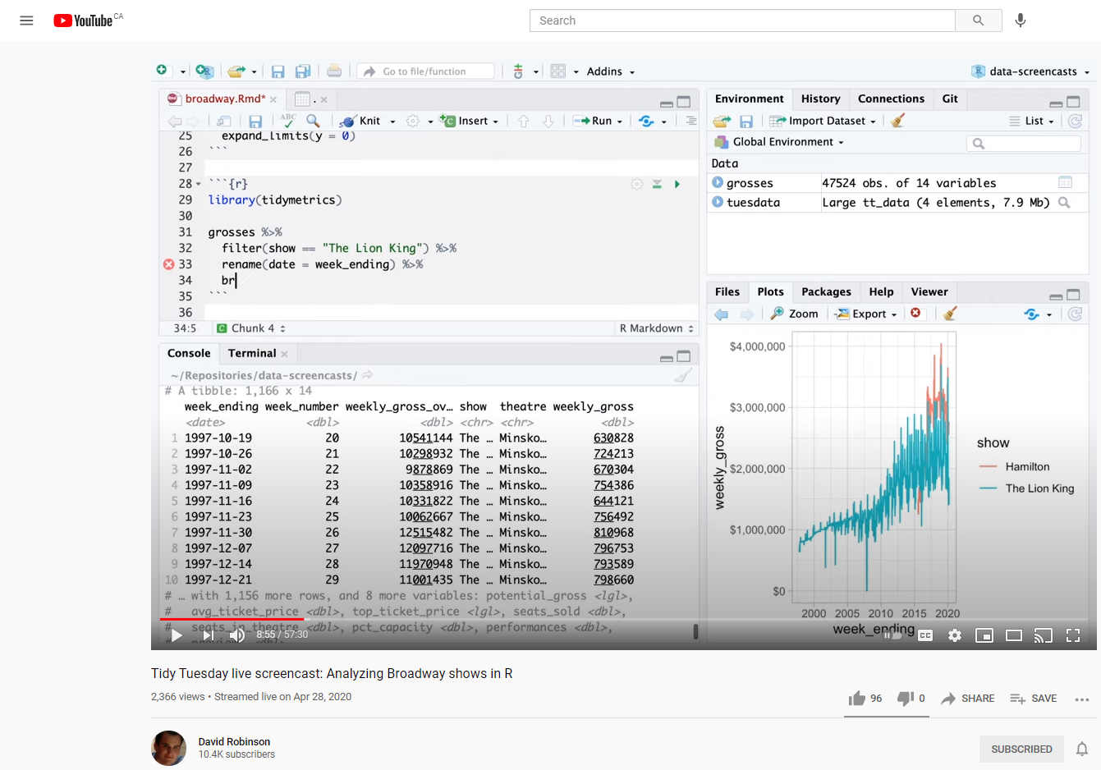

Falling In Love

Slide 28
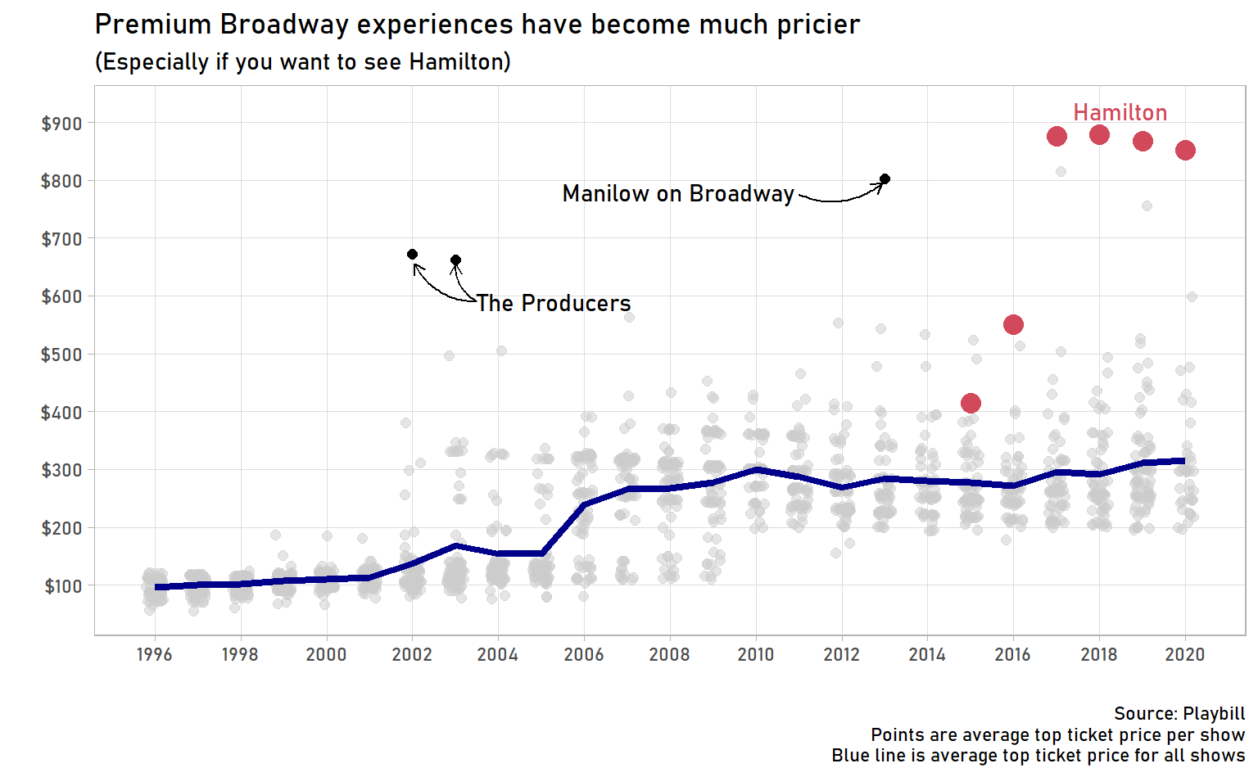
Falling In Love

Slide 29
Falling In Love
Is Hamilton’s success unprecedented?

Slide 30
Falling In Love
No! The Producers was the Hamilton of its day
Is Hamilton’s success unprecedented?

Slide 31
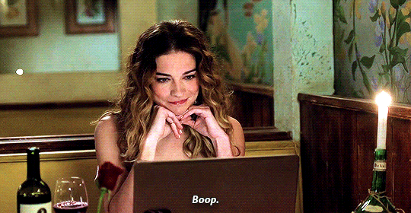
Falling In Love

Slide 32
Great Datasets: A Story
_

Slide 33
Great Datasets: A Story
—
—
^
ies
—
^
Many
_

Slide 34
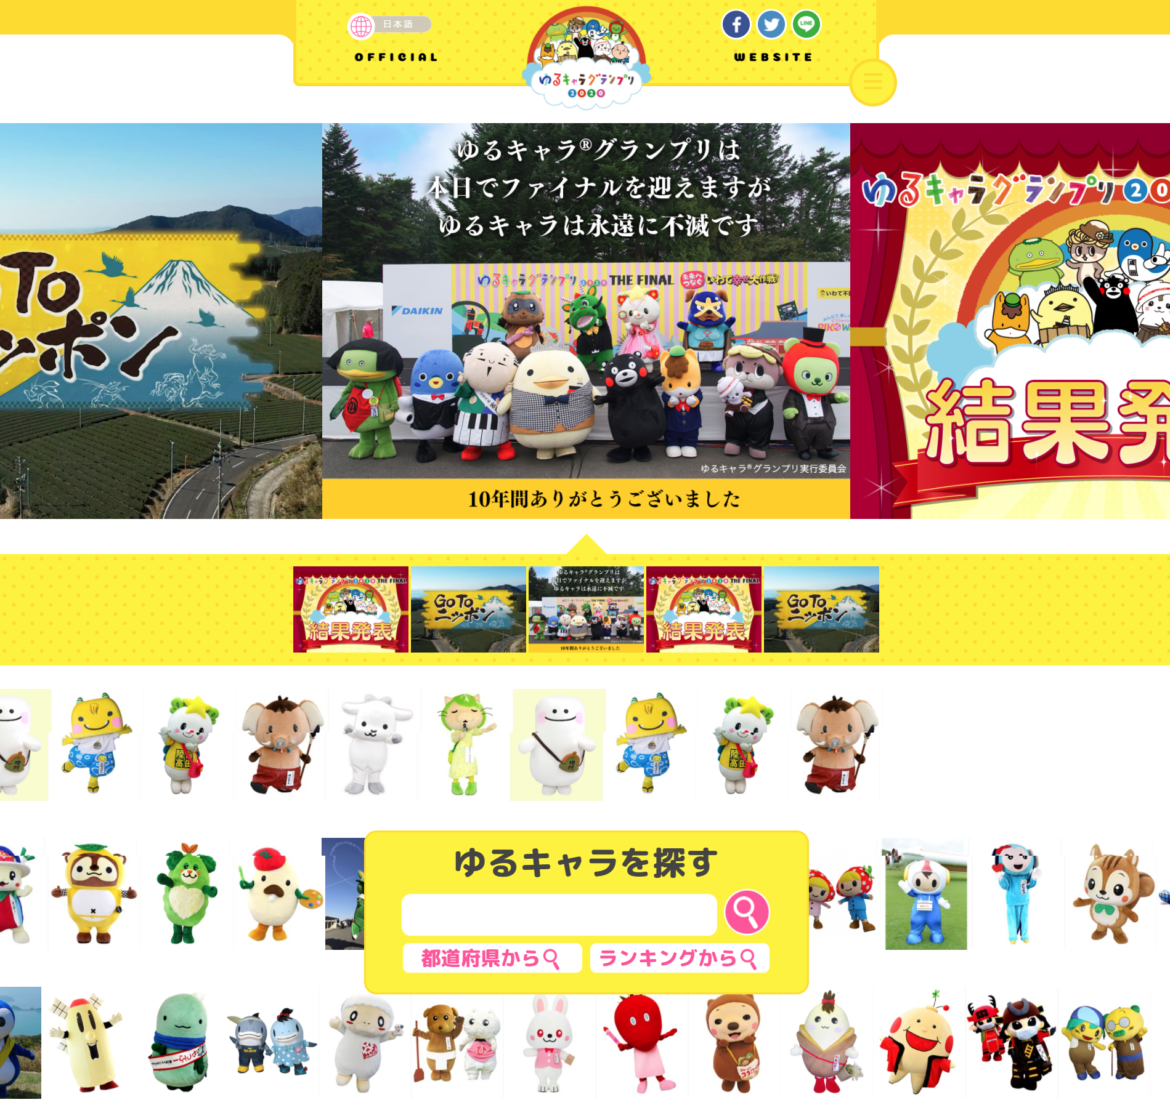
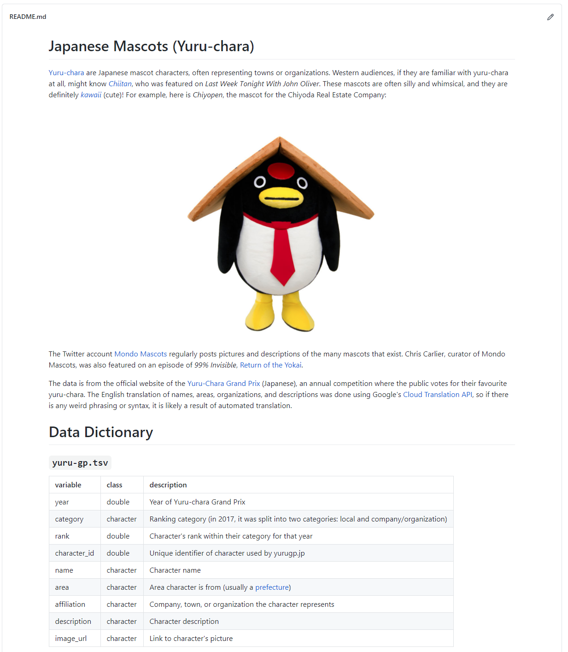
This Love Story kept repeating itself

Slide 35
This Love Story kept repeating itself
More web scraping!
Using Google Language API with {googleLanguageR}

Slide 36
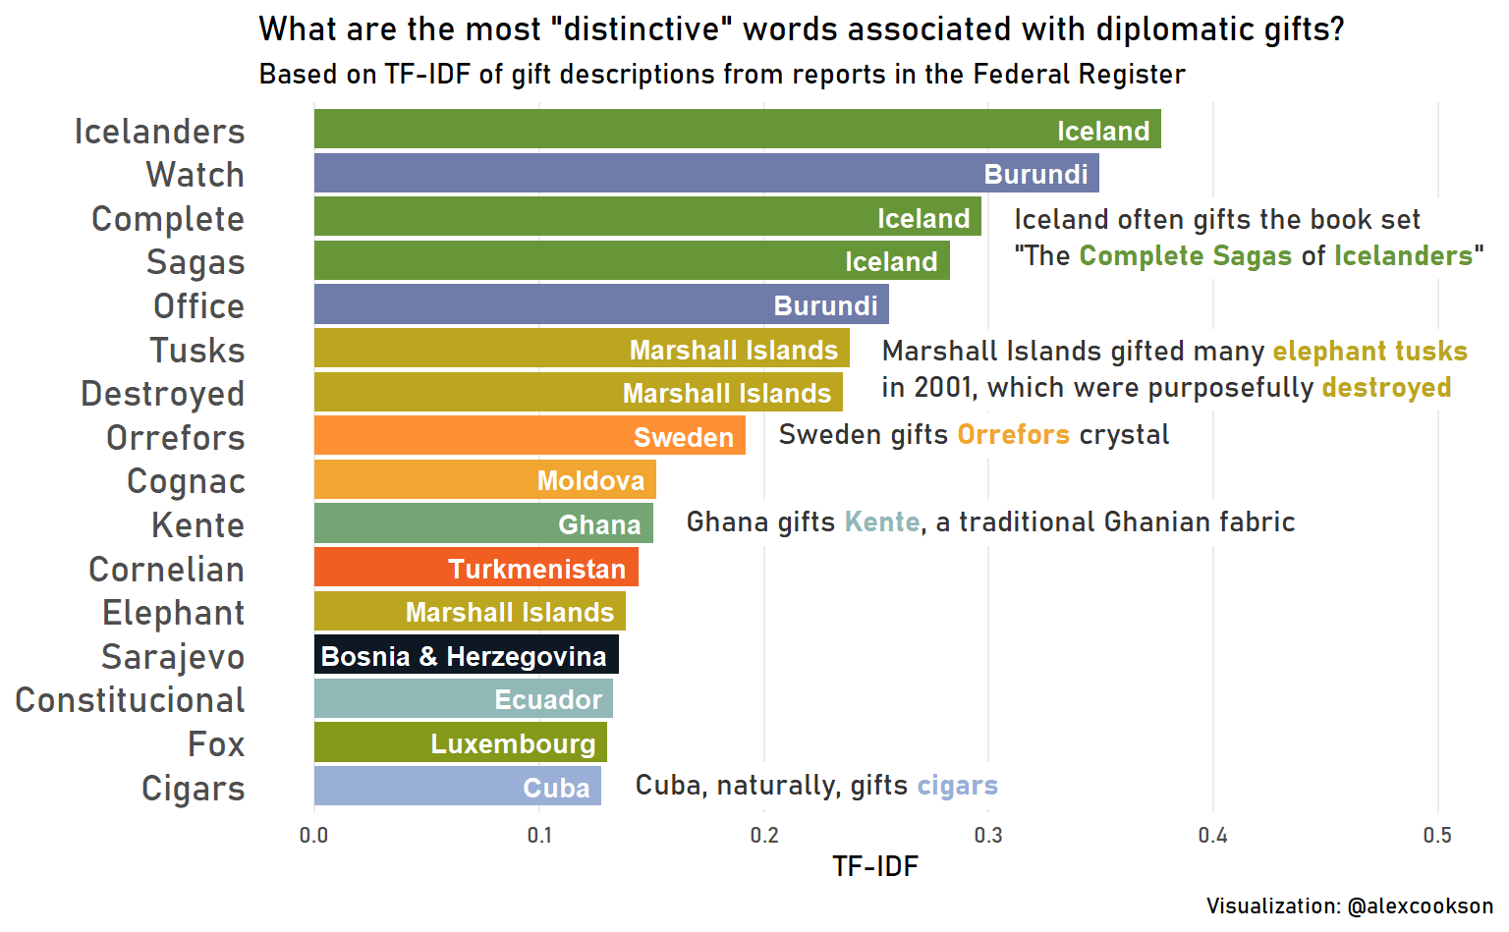
This Love Story kept repeating itself

Slide 37
This Love Story kept repeating itself
Parsing dirty PDF data
Annotations and text formatting with {ggtext}
Basic Natural Language Processing (TF-IDF)

Slide 38
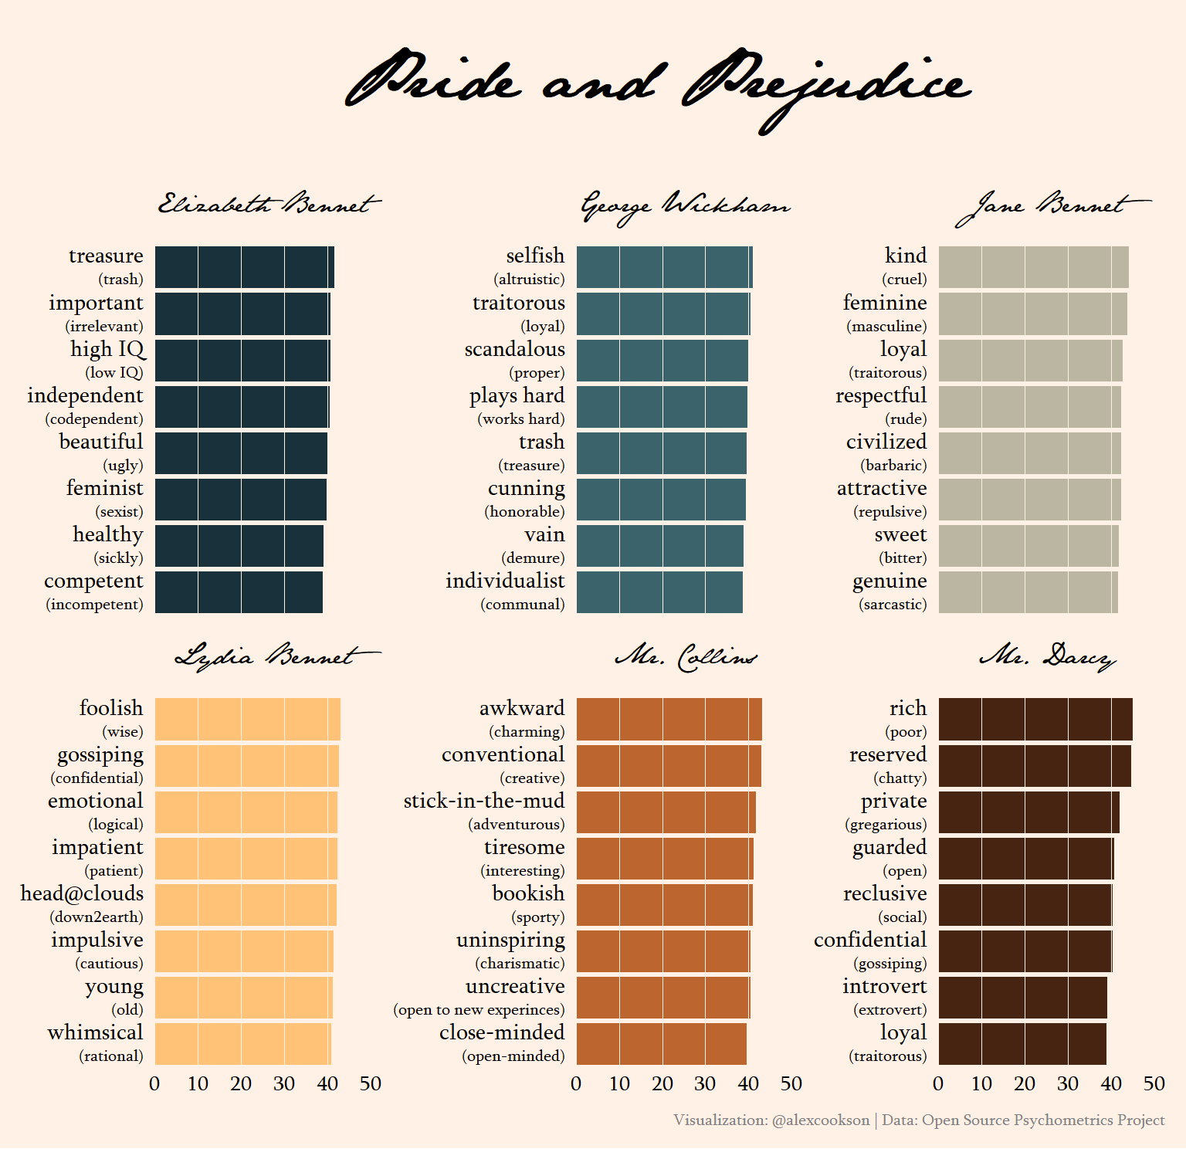
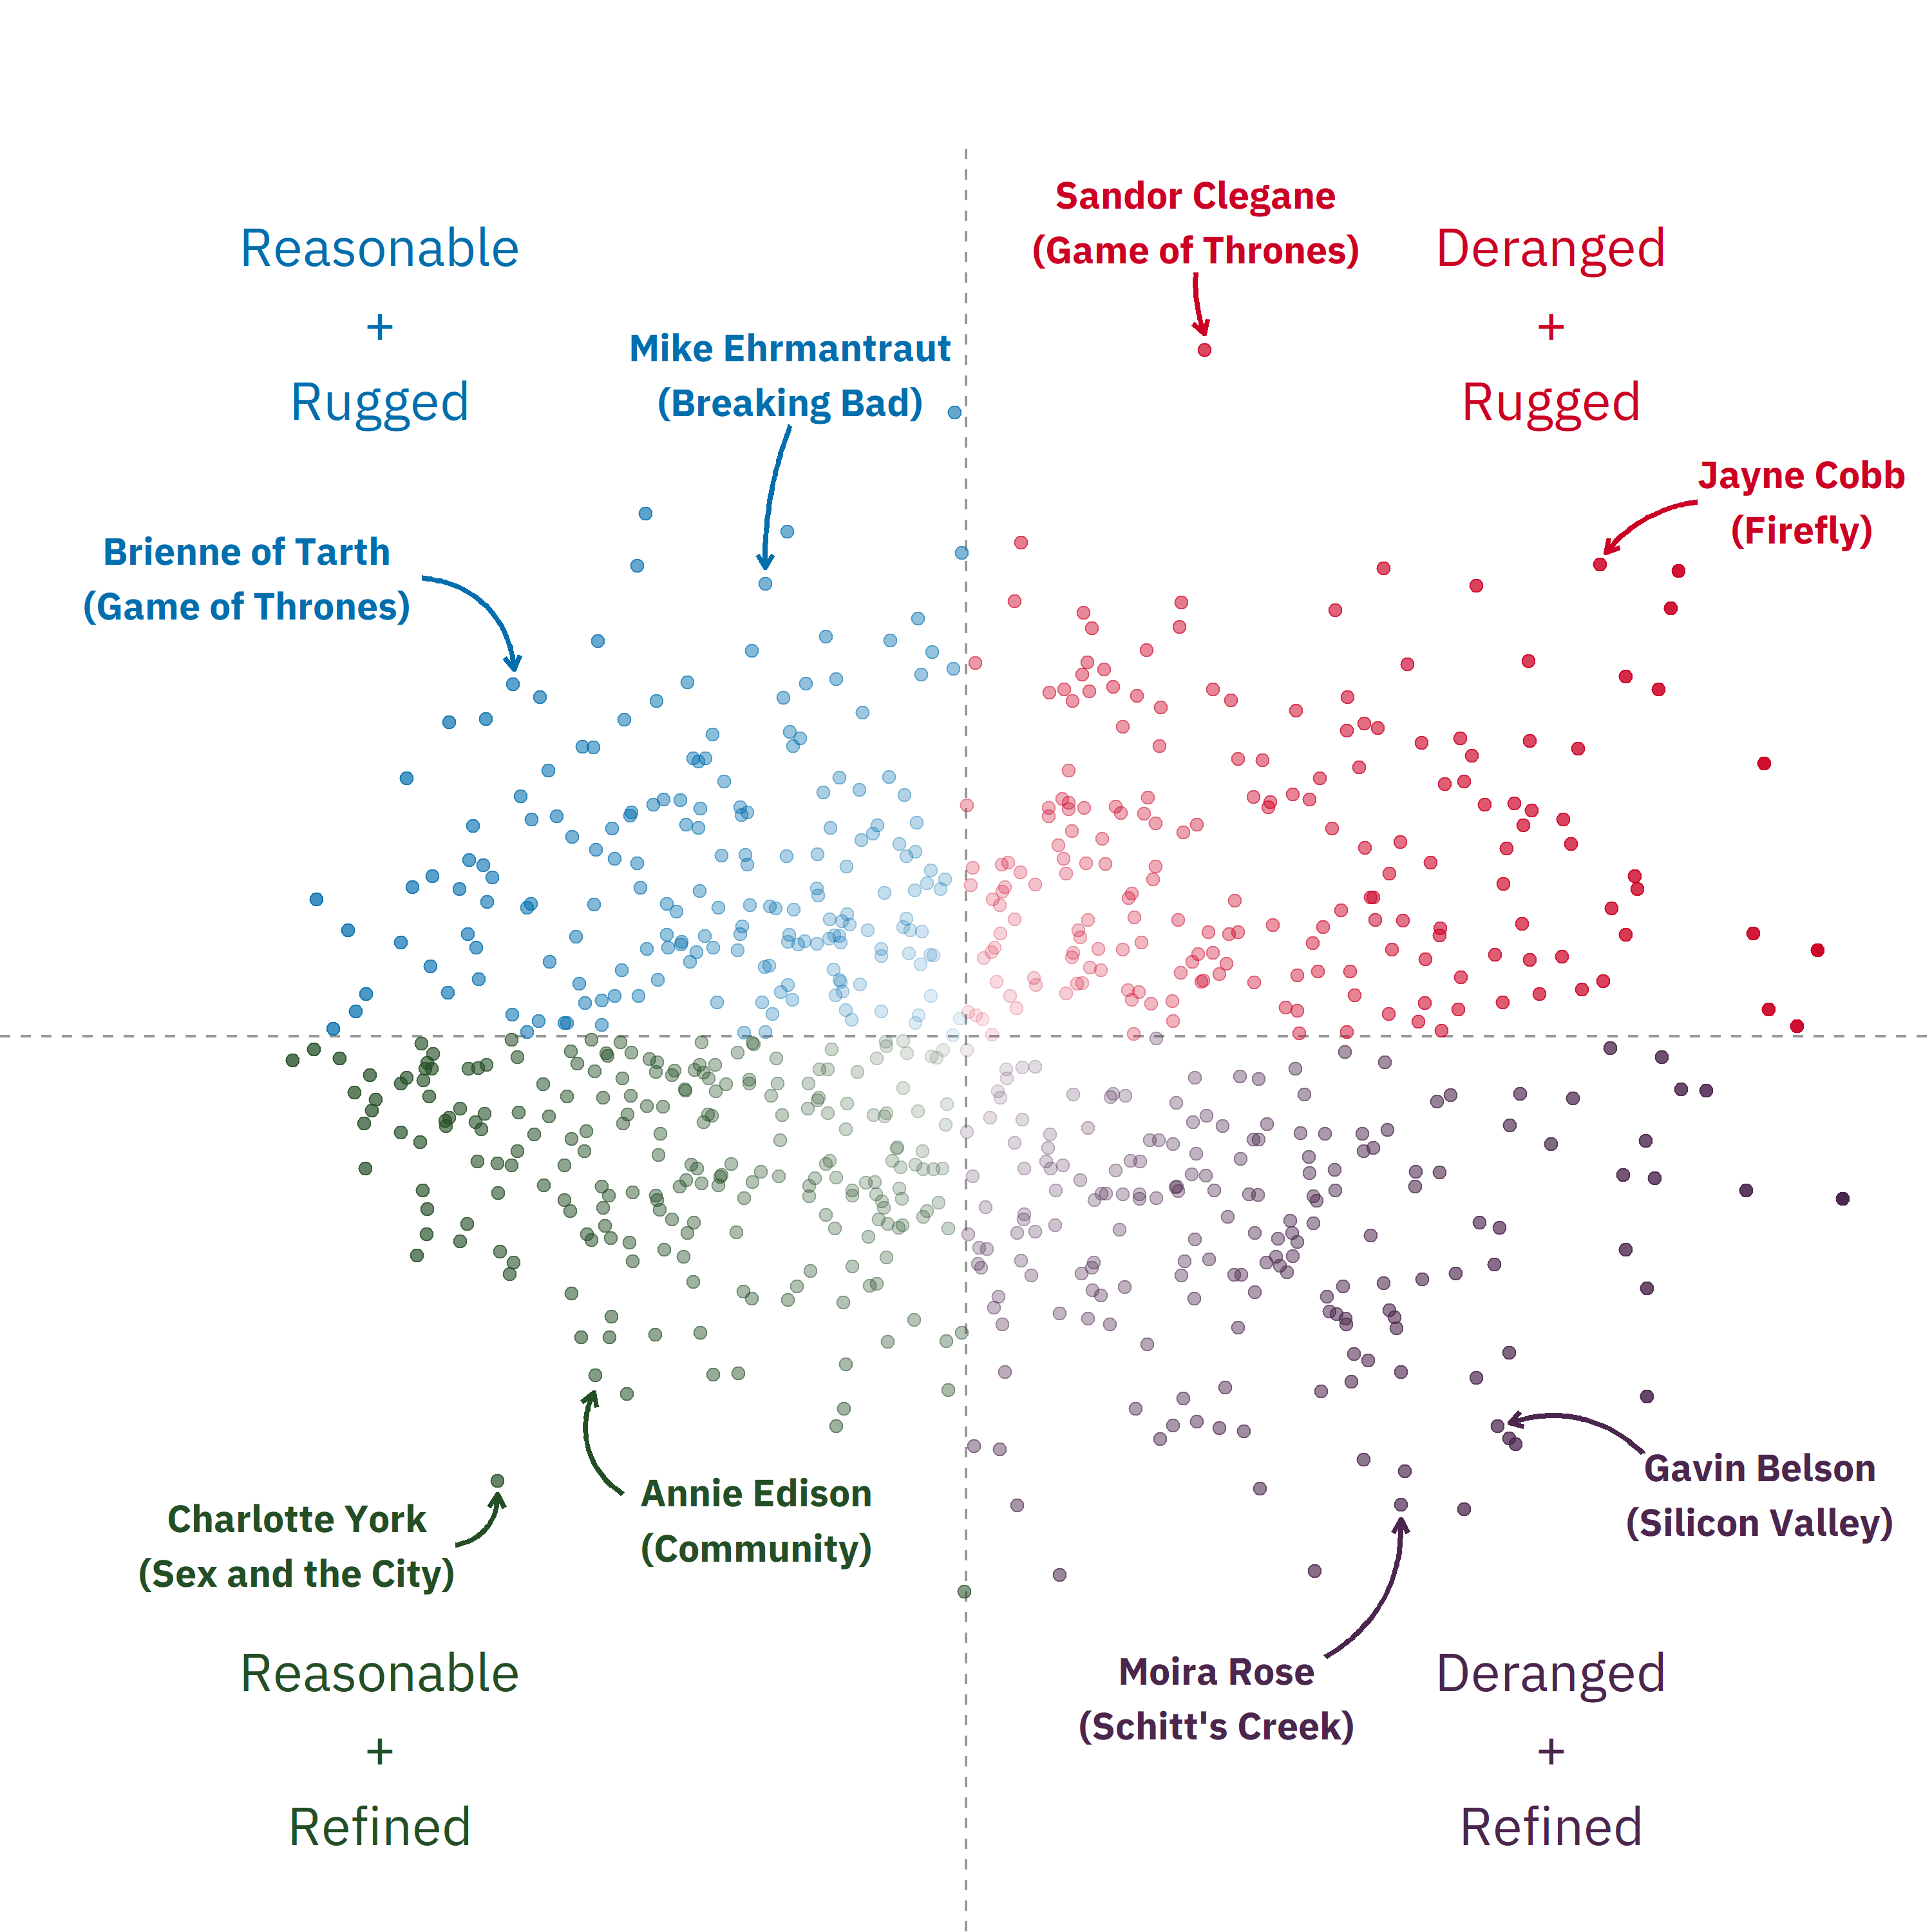
This Love Story kept repeating itself

Slide 39
This Love Story kept repeating itself
More text formatting with {ggtext}
Principal Component Analysis (PCA)
Creating beautiful graphs with {ggplot2}
{tidymodels} framework
Interactive scatter plot with {plotly}

Slide 40

This Love Story kept repeating itself
So. Much. {gganimate}.
Text formatting with {ggtext}. Again.
Custom icons with {ggimage}
Installing and using custom fonts

Slide 41
The One Big Benefit (and Two Small Benefits) of Great Datasets

Slide 42
Great Datasets are… a Learning Path

Slide 43
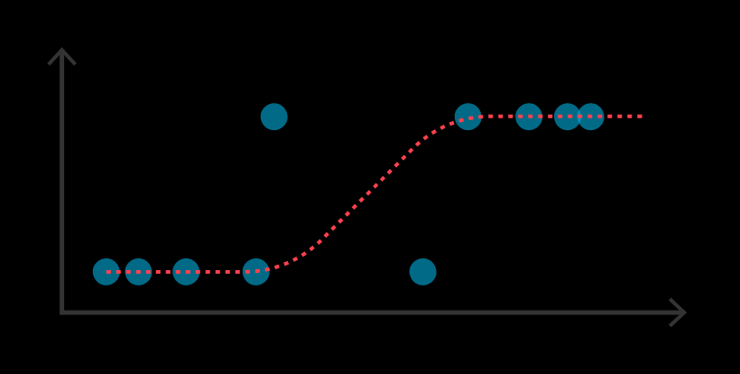
Great Datasets are…a Learning Path
“I want to learn logistic regression”
Titanic Passengers

Slide 44
Great Datasets are…a Learning Path
1. Decide what you want to learn
“I want to learn logistic regression”
Titanic Passengers

Slide 45
Great Datasets are…a Learning Path
1. Decide what you want to learn
2. Find a dataset to practice on
“I want to learn logistic regression”
Titanic Passengers

Slide 46
Great Datasets are…a Learning Path
1. Decide what you want to learn
2. Find a dataset to practice on
3. Achieve the outcome
“I want to learn logistic regression”
Titanic Passengers

Slide 47
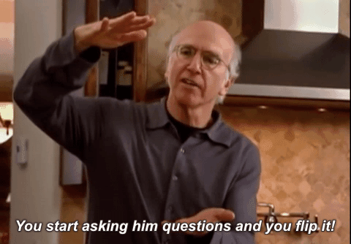
Flip it!

Slide 48
Great Datasets are…a Learning Path
Web scraping?
Time-series analysis?
Forecasting?
NLP?
Causal inference?
What questions do I have for this data?
Broadway Grosses

Slide 49
Great Datasets are…a Learning Path
1. Find a dataset that piques your curiosity
Web scraping?
Time-series analysis?
Forecasting?
NLP?
Causal inference?
What questions do I have for this data?
Broadway Grosses

Slide 50
Great Datasets are…a Learning Path
1. Find a dataset that piques your curiosity
2. Let your curiosity
guide you
Web scraping?
Time-series analysis?
Forecasting?
NLP?
Causal inference?
What questions do I have for this data?
Broadway Grosses

Slide 51
Great Datasets are…a Learning Path
1. Find a dataset that piques your curiosity
2. Let your curiosity
guide you
3. Learn something as a by-product
Web scraping?
Time-series analysis?
Forecasting?
NLP?
Causal inference?
What questions do I have for this data?
Broadway Grosses

Slide 52
Great Datasets are…a Learning Path
Focus on this…
1. Find a dataset that piques your curiosity
2. Let your curiosity
guide you
3. Learn something as a by-product
Web scraping?
Time-series analysis?
Forecasting?
NLP?
Causal inference?
What questions do I have for this data?
Broadway Grosses

Slide 53
Great Datasets are…a Learning Path
Focus on this…
…not this
1. Find a dataset that piques your curiosity
2. Let your curiosity
guide you
3. Learn something as a by-product
Web scraping?
Time-series analysis?
Forecasting?
NLP?
Causal inference?
What questions do I have for this data?
Broadway Grosses

Slide 54
Great Datasets are… Sharing who you are

Slide 55
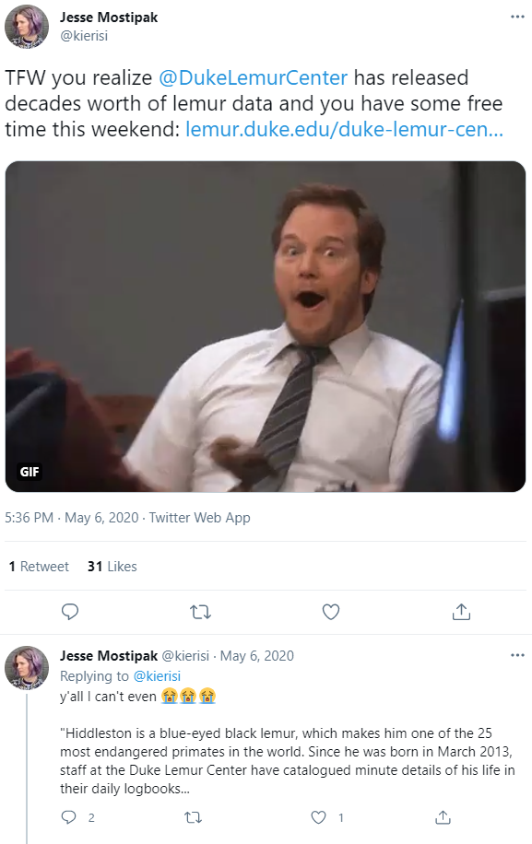
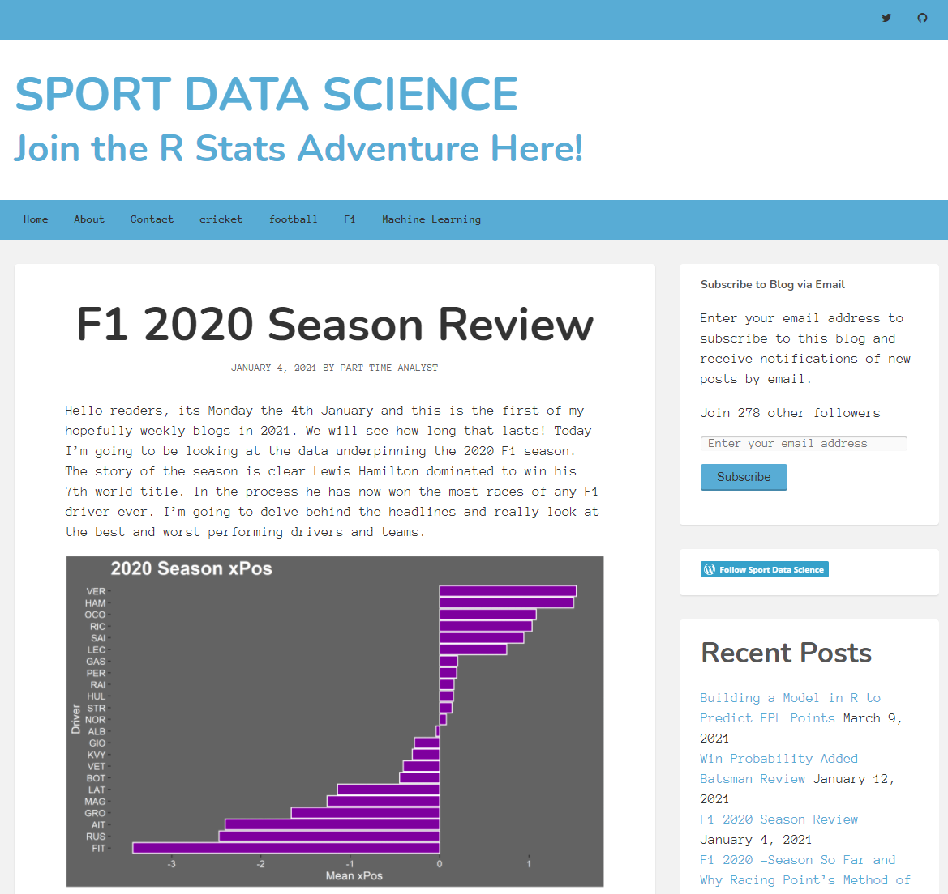
Great Datasets are…Sharing who you are

Slide 56
Great Datasets are… Community-builders

Slide 57

Great Datasets are…Community-builders
Me when someone likes a tweet about a dataset I shared
If you like a dataset…so does someone else
More (and more diverse) datasets enrich the community
Curating and sharing datasets is a way for you to engage with the community

Slide 58
Okay Alex, I’m convinced!
How do I start?

Slide 59
Getting Going with Great Datasets
Start with existing datasets (TidyTuesday, Kaggle, my data repository)
Don’t force it – know your interests and be watchful
Know that curating your own datasets will probably involve web scraping
Share! Encouragement from others is a great motivator

Slide 60
Getting Going with Great Datasets
Start with existing datasets (TidyTuesday, Kaggle, my data repository)
Don’t force it – know your interests and be watchful
Know that curating your own datasets will probably involve web scraping
Share! Encouragement from others is a great motivator

Slide 61
Getting Going with Great Datasets
Start with existing datasets (TidyTuesday, Kaggle, my data repository)
Don’t force it – know your interests and be watchful
Know that curating your own datasets will probably involve web scraping
Share! Encouragement from others is a great motivator

Slide 62
Getting Going with Great Datasets
Start with existing datasets (TidyTuesday, Kaggle, my data repository)
Don’t force it – know your interests and be watchful
Know that curating your own datasets will probably involve web scraping
Share! Encouragement from others is a great motivator

Slide 63
Great Datasets: A Story
Alex Cookson
@alexcookson
tacookson
_

